Slide 1
Password Management and Hashing Algorithms
Long Nguyen

Slide 2
Table of Contents
Password Management
1
Hasing Algorithms
2

Slide 3
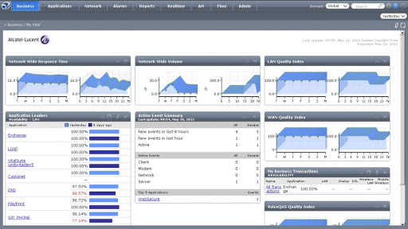
Password Management
Flashback: Nokia VitalSuite®

Slide 4


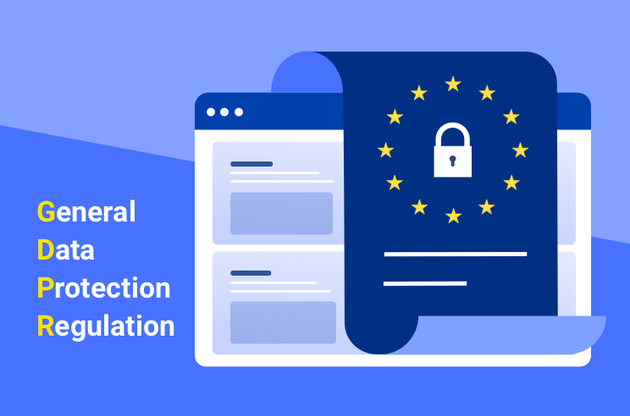
Nokia VitalSuite®
Sale VitalSuite for EU
Ok
Ok
Ok

Slide 5

GDPR - General Data Protection Regulation
1. This Regulation lays down rules relating to the protection of natural persons with regard to the processing of personal data and rules relating to the free movement of personal data.
2. This Regulation protects fundamental rights and freedoms of natural persons and in particular their right to the protection of personal data.
3. The free movement of personal data within the Union shall be neither restricted nor prohibited for reasons connected with the protection of natural persons with regard to the processing of personal data.

Slide 6
GDPR Compliance
Why VitalSuite® did not meet the GDPR requierments?
1. Appending personal identifiable information to the the URL on form submissions, e.g: 192.168.83.172/login?username=admin&password=admin
2. Storing user personal data such as: email, public key,... as plan text in database
3. Repeated failed login attempts.
4. Obsoleted password hashing algorithm.
What is the solutions?
1. Send sensitive information in the request body.
2. encrypt/decrypt personal information when write into/read from database.
3. Exponentially increase time between each login attemps, login attempt limit.
4. Up-to-date hashing algorithm for password that stored in database.
Notes:
Insert into UserTable values('admin', 0, 's0xX0c5_8cB3GsJRO0TXWc__ccf3ksnR', 1, ' ', ' ', ' ', ' ', 4, 200, null, 0, 0, 1, 0, 0, null, 100, 10);

Slide 7
Password Management
The security of users’ passwords is one of the most important aspects of developing your application.
The best way is not to store passwords at all, but… sometimes you have to.
A user's online and offline identity should not be threatened because your systems failed to be secured properly.
Any passwords that stored in your application's database can be stolen if the database is compromised, and then immediately used to compromise not only your application, but also the accounts of your users on other services, if they do not use unique passwords.

Slide 8
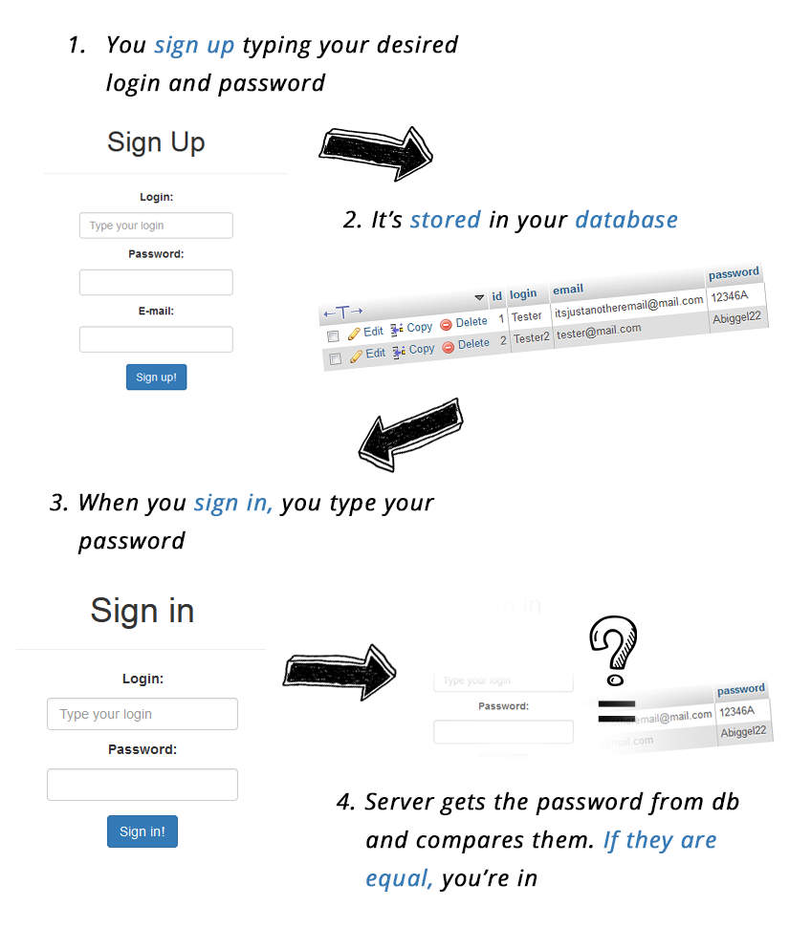
Password Management
How does it work?
It seems really simple. When you register, you choose your login and a password. They are saved to the database. Then when you log in, the server compares what you typed in the login box with the data from the database and if it’s equal, it lets you in.

Slide 9
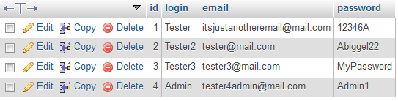
What if you get hacked?
They hacked one password, the one to your DB, and they have got access to all accounts created in your service.
https://plaintextoffenders.com/
Notes:
“So what?”, you could say if your website has nothing to do with money or any other important data, but… take into account that it’s common for people to use the same password for different services. So the password used on your website could be valid (often with the same login and email!) also emphasized text for Facebook, Youtube… you name it!
Ok, this approach seems naive now, but if you think there aren’t any websites with such an authentication method, you’re wrong. How to identify such services? By their ability to send you your password by email if you forget it.

Slide 10
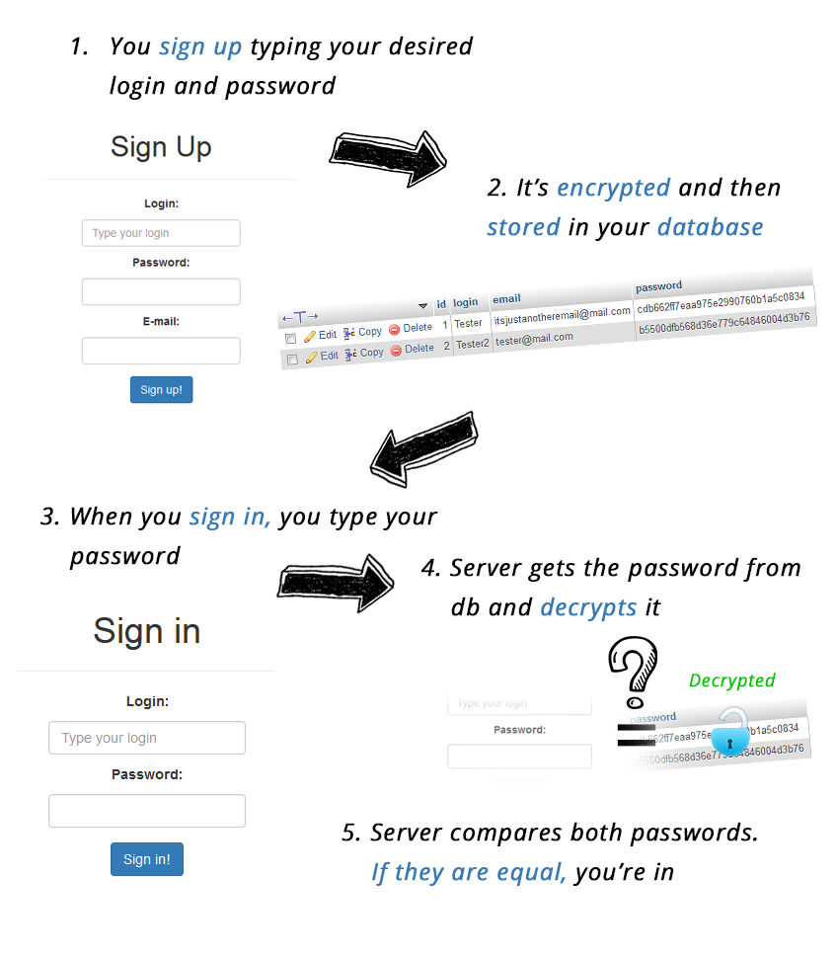
What can we do to strengthen our defense?
Encrypting
Now user passwords get encrypted before they are stored in the database. When your user signs in, the service gets an encrypted password from the database, decrypt it and then compares it with the password you typed. If they’re the same, the service lets you in.

Slide 11
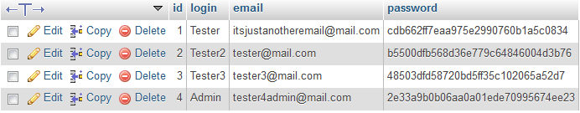
What can we do to strengthen our defense?
It seems more secure, because now when somebody just reads out your database, he sees something like this:

Slide 12
What is the problem with Encrypting?
If somebody has an access to your database, they can set up a new account with his password and then by searching their record in the database, just copy their encrypted passwords and paste it to every account they want. Then, with their password, they can sign in to every account, even yours – the one with admin permissions! It’s bad, but at least they don’t have passwords of users, so they can’t use them in other websites.
Encrypting is a two-way function. It’s reversible so you can always decrypt the string and get the original one if you have the key.
Encryption of the same password will be always the same so you could end with a database where encrypted passwords are repeated

Slide 13
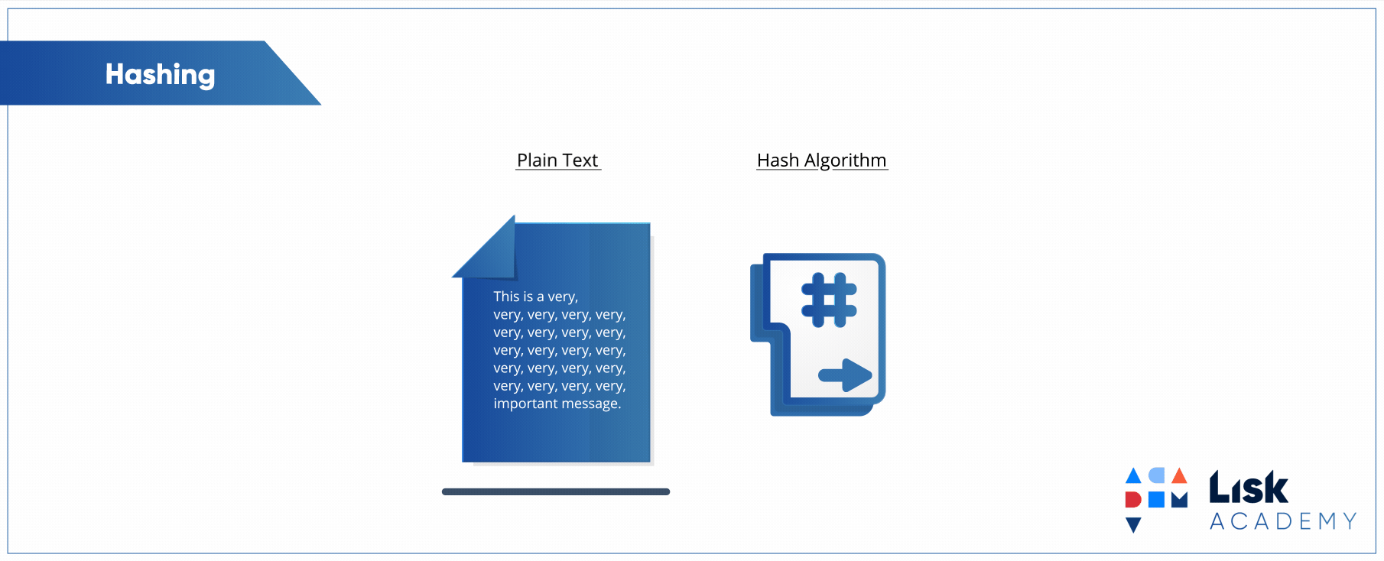
Hashing
So encrypting seems quite a good idea, but the encryption key makes it really unsafe. How can we get rid of an encryption key? By making our encryption one-way only. If we encrypt and never decrypt, we don’t need an encryption key.

Slide 14
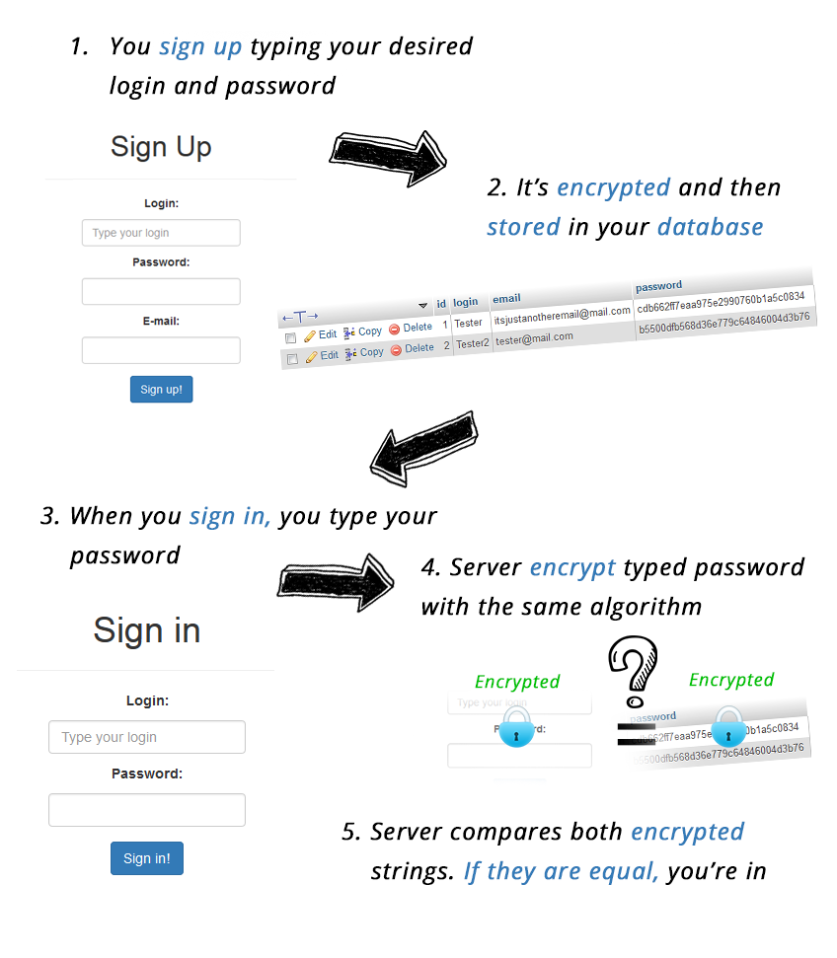
Hashing
How does it work?
The same as before we encrypt the password before storing it in the database. The thing that has changed is the part when we sign in. This time, we don’t decrypt our password from the database (we don’t have any key, so we can’t do it anyway), instead, we encrypt typed password in the same way, with the same algorithm as we had done it while registering. If both encrypted strings (typed password and password from DB) are the same, you’re in.

Slide 15
Hashing Algorithims
Hashing algorithms are functions that generate a fixed-length result (the hash, or hash value) from a given input. The hash value is a summary of the original data.
A hashing algorithm is a cryptographic hash function. It is a mathematical algorithm that maps data of arbitrary size to a hash of a fixed size.
It’s designed to be a one-way function, infeasible to invert
Now we have a question, what password digesting algorithm should we choose? The most popular ones are MD5 and SHA1, SHA2 (from SHA family), bcrypt, scrypt, Argon2

Slide 16
Hashing Algorithims
It’s easy to figure out what the ideal cryptographic hash function should be like:
It should be fast to compute the hash value for any kind of data.
It should be impossible to regenerate a message from its hash value (brute force attack as the only option).
It should be infeasible to find two messages with the same hash (a collision).
Every change to a message, even the smallest one, should change the hash value. It should be completely different.

Slide 17

Hashing Algorithims
MD5 have been compromised, easy to reverse -> digital signatures.
SHA1 is now unsafe
SHA2 (SHA256, SHA512) are all fast hashes and are bad for passwords.
SCRYPT, BCRYPT Argon2 are slow hashes and are good for passwords.
Argon2
4
Bcrypt, Scrypt
3
SHA Family
2
MD5
1
Notes:
in recent years several hashing algorithms have been compromised. This happened to MD5, for example — a widely known hash function designed to be a cryptographic hash function, which is now so easy to reverse — that we could only use for verifying data against unintentional corruption.

Slide 18
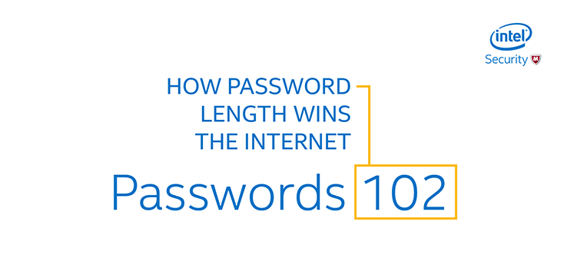
How to crack a hash
Dictionary and Brute Force Attacks
Lookup Tables
Reverse Lookup Tables
Rainbow Tables
NOTE: Simply hashing the password a single time does not sufficiently protect the password. Use iterative hashing with a random salt to make the hash strong.

Slide 19

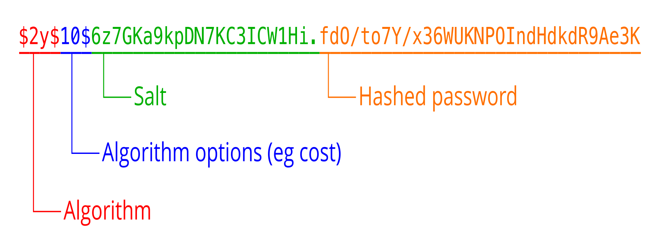
Salting
The salt is a random sequence of bytes that is added to the password before being digested. This causes the digest to be different than the normal encryption. It protects us really well against rainbow tables/dictionary attacks.

Slide 20
Where to hash?
The salt is a random sequence of bytes that is added to the password before being digested. This causes the digest to be different than the normal encryption. It protects us really well against rainbow tables/dictionary attacks.

Slide 21
Conclusion
Storing passwords as hashes.
Hashing should be done in server side.
Use slow hashing algorithms.
Use iterative hashing with a random salt to make the hash strong.
The best way is not to store passwords at all, but… sometimes you have to.

Slide 22
Ref
http://www.sha1-online.com/
https://crackstation.net/
https://freerainbowtables.com/
https://crackstation.net/hashing-security.htm
https://medium.com/analytics-vidhya/password-hashing-pbkdf2-scrypt-bcrypt-and-argon2-e25aaf41598e
https://www.alexedwards.net/blog/how-to-hash-and-verify-passwords-with-argon2-in-go
https://blog.jscrambler.com/how-to-store-passwords-safely/
https://blog.jscrambler.com/hashing-algorithms/#:~:text=Hashing%20algorithms%20are%20functions%20that,to%20read%20its%20content%20anymore.
https://www.php.net/manual/en/faq.passwords.php

Slide 23
THANK YOU

